Slide 1
PERCENTAGE
Definition, Percentage change.

Slide 2
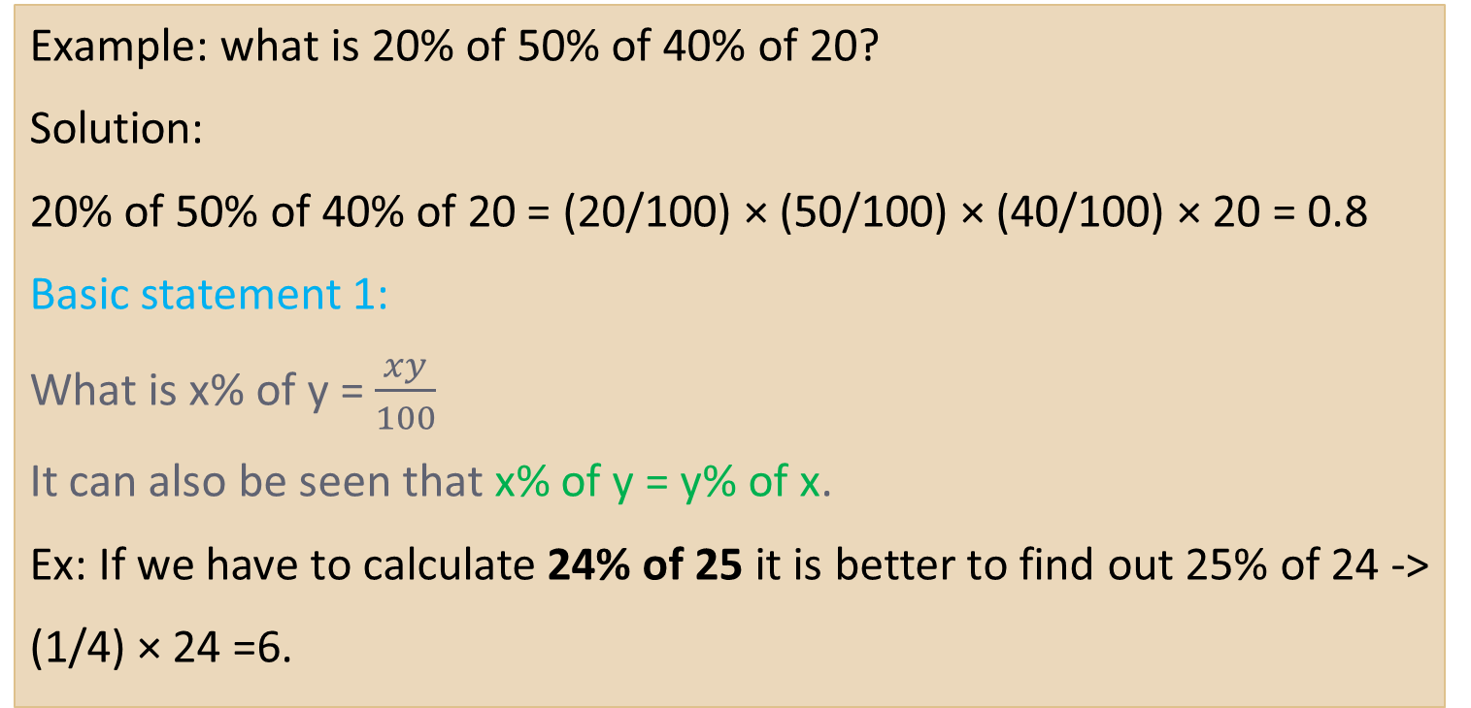
Percentage means ‘per hundred’
Example: what is 20% of 50% of 40% of 20?
Solution:
20% of 50% of 40% of 20 = (20/100) × (50/100) × (40/100) × 20 = 0.8
Basic statement 1:
What is x% of y = $\frac{xy}{100}$
It can also be seen that x% of y = y% of x.
Ex: If we have to calculate 24% of 25 it is better to find out 25% of 24 ->
(1/4) × 24 =6.

Slide 3

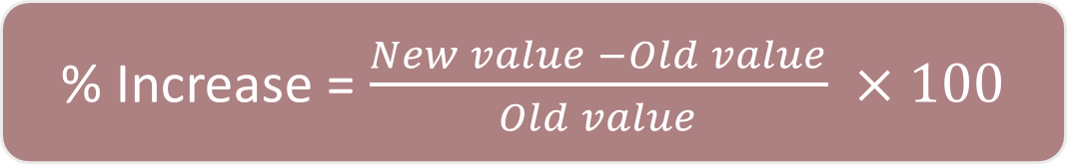
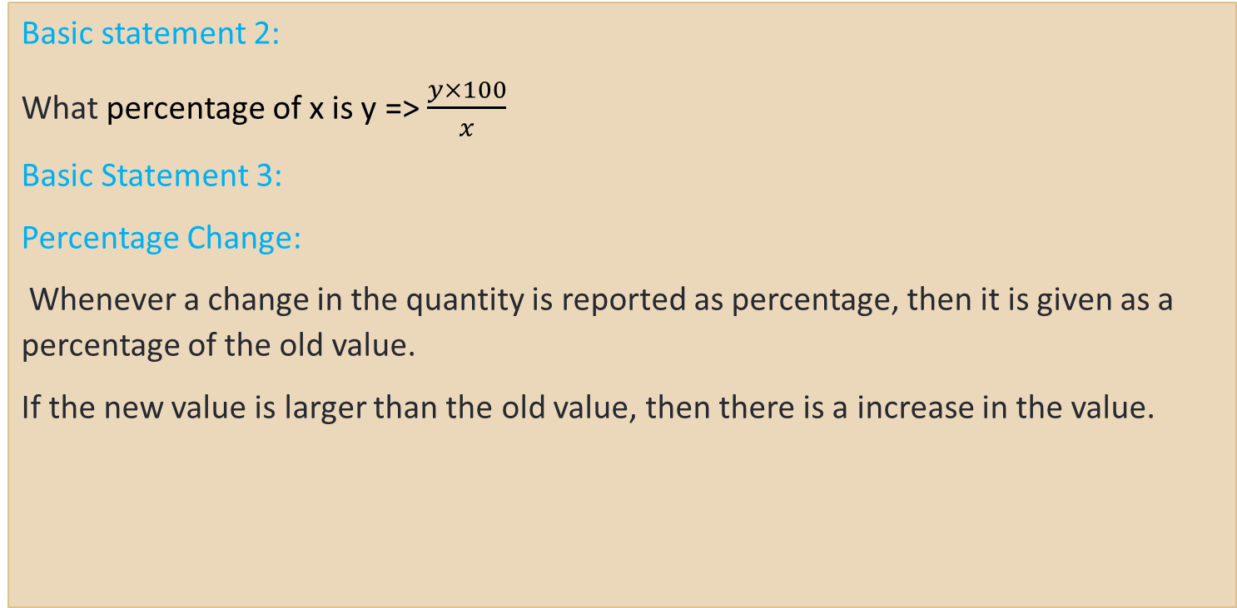
Percentage Change
Basic statement 2:
What percentage of x is y => $\frac{y×100}{x}$
Basic Statement 3:
Percentage Change:
Whenever a change in the quantity is reported as percentage, then it is given as a percentage of the old value.
If the new value is larger than the old value, then there is a increase in the value.
% Increase = $\frac{New value −Old value}{Old value} ×100$

Slide 4
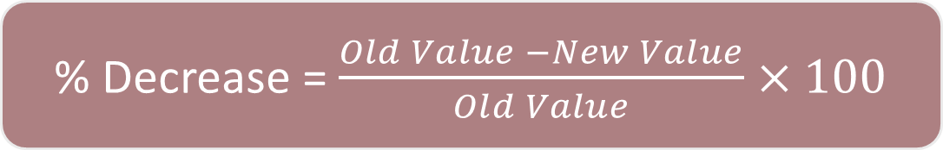
Percentage Change
If the new value is smaller than the old value, then there is a decrease in the value.
INITIAL VALUE + % CHANGE = FINAL VALUE.
There are three different ways to analyse percentage change and final value after change.
Percentage Change as Addition
Percentage change as Multiple
Percentage change as Fractions (Unitary Method)
% Decrease = $\frac{Old Value −New Value}{Old Value}×100$

Slide 5

Percentage Change
PERCENTAGE CHANGE AS ADDITION :
Let us now take 40 as initial value and percentage change as 20%. Now let us analyse % change and final value in three different forms.
Now, think in reverse manner:
It is difficult to find the initial value if final value is already given.

Slide 6


Percentage Change
PERCENTAGE CHANGE AS MULTIPLE :
Think increase and decrease in the following way :
20% ↑ = 1.20
30% ↓ = 0.70
Now think in the reverse manner:
In case of reverse just divide 48 by 1.2 as rather multiply.
48/1.2 = 40 (initial)

Slide 7

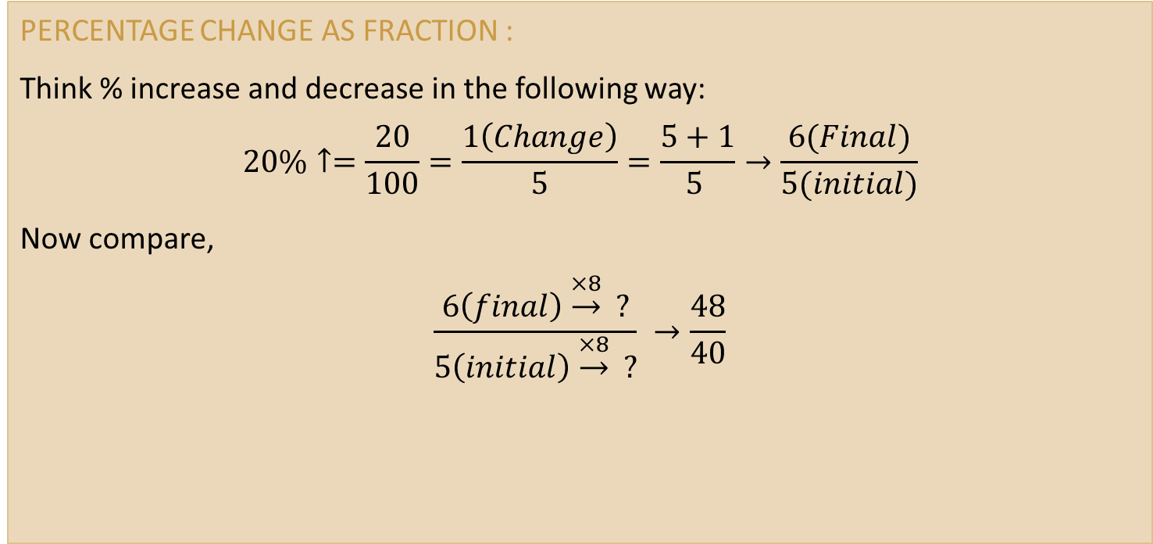
Percentage Change
PERCENTAGE CHANGE AS FRACTION :
Think % increase and decrease in the following way:
$$20\%↑=\frac{20}{100}=\frac{1\left(Change\right)}{5}=\frac{5+1}{5 }→\frac{6(Final)}{5(initial)}$$
Now compare,
$$\frac{6\left(final\right)\underset{→}{×8} ?}{5\left(initial\right)\underset{→}{×8} ?} →\frac{48}{40}$$

Slide 8

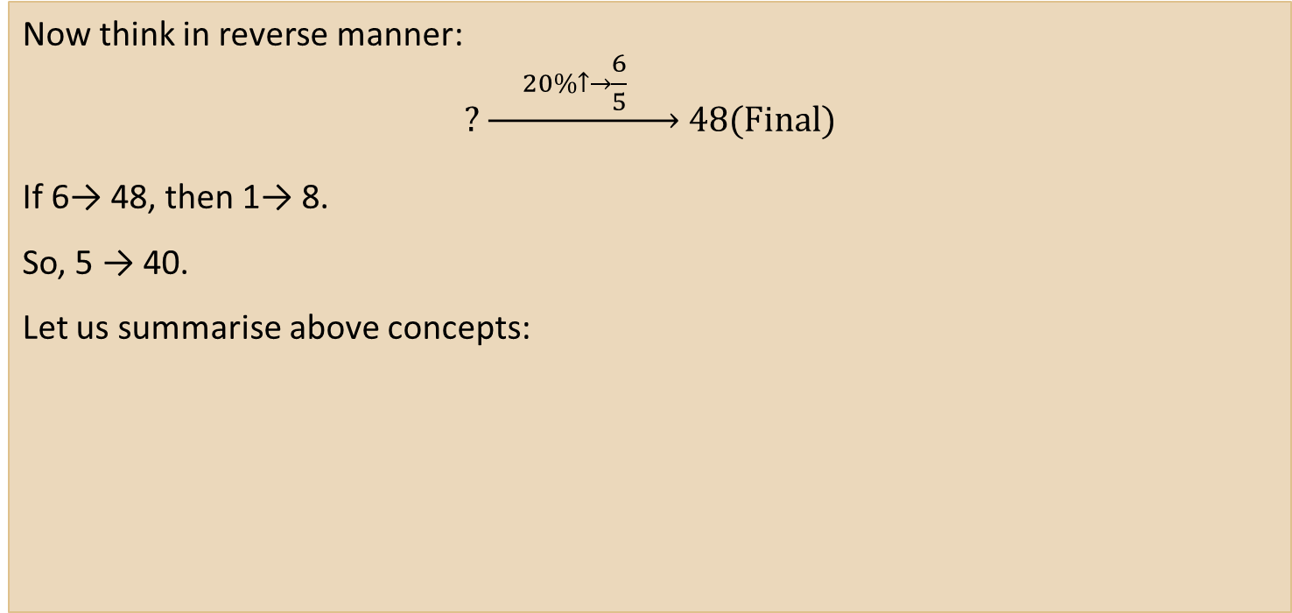
Percentage Change
Now think in reverse manner:
$$?\underset{→}{ 20\%↑→\frac{6}{5} } 48(Final)$$
If 6→ 48, then 1→ 8.
So, 5 → 40.
Let us summarise above concepts:

Slide 9


